Slide 1

Prolog: Language for AI
Programming Logic
AIFA, AI61005, 2021 Autumn
Plaban Kumar Bhowmick

Slide 2
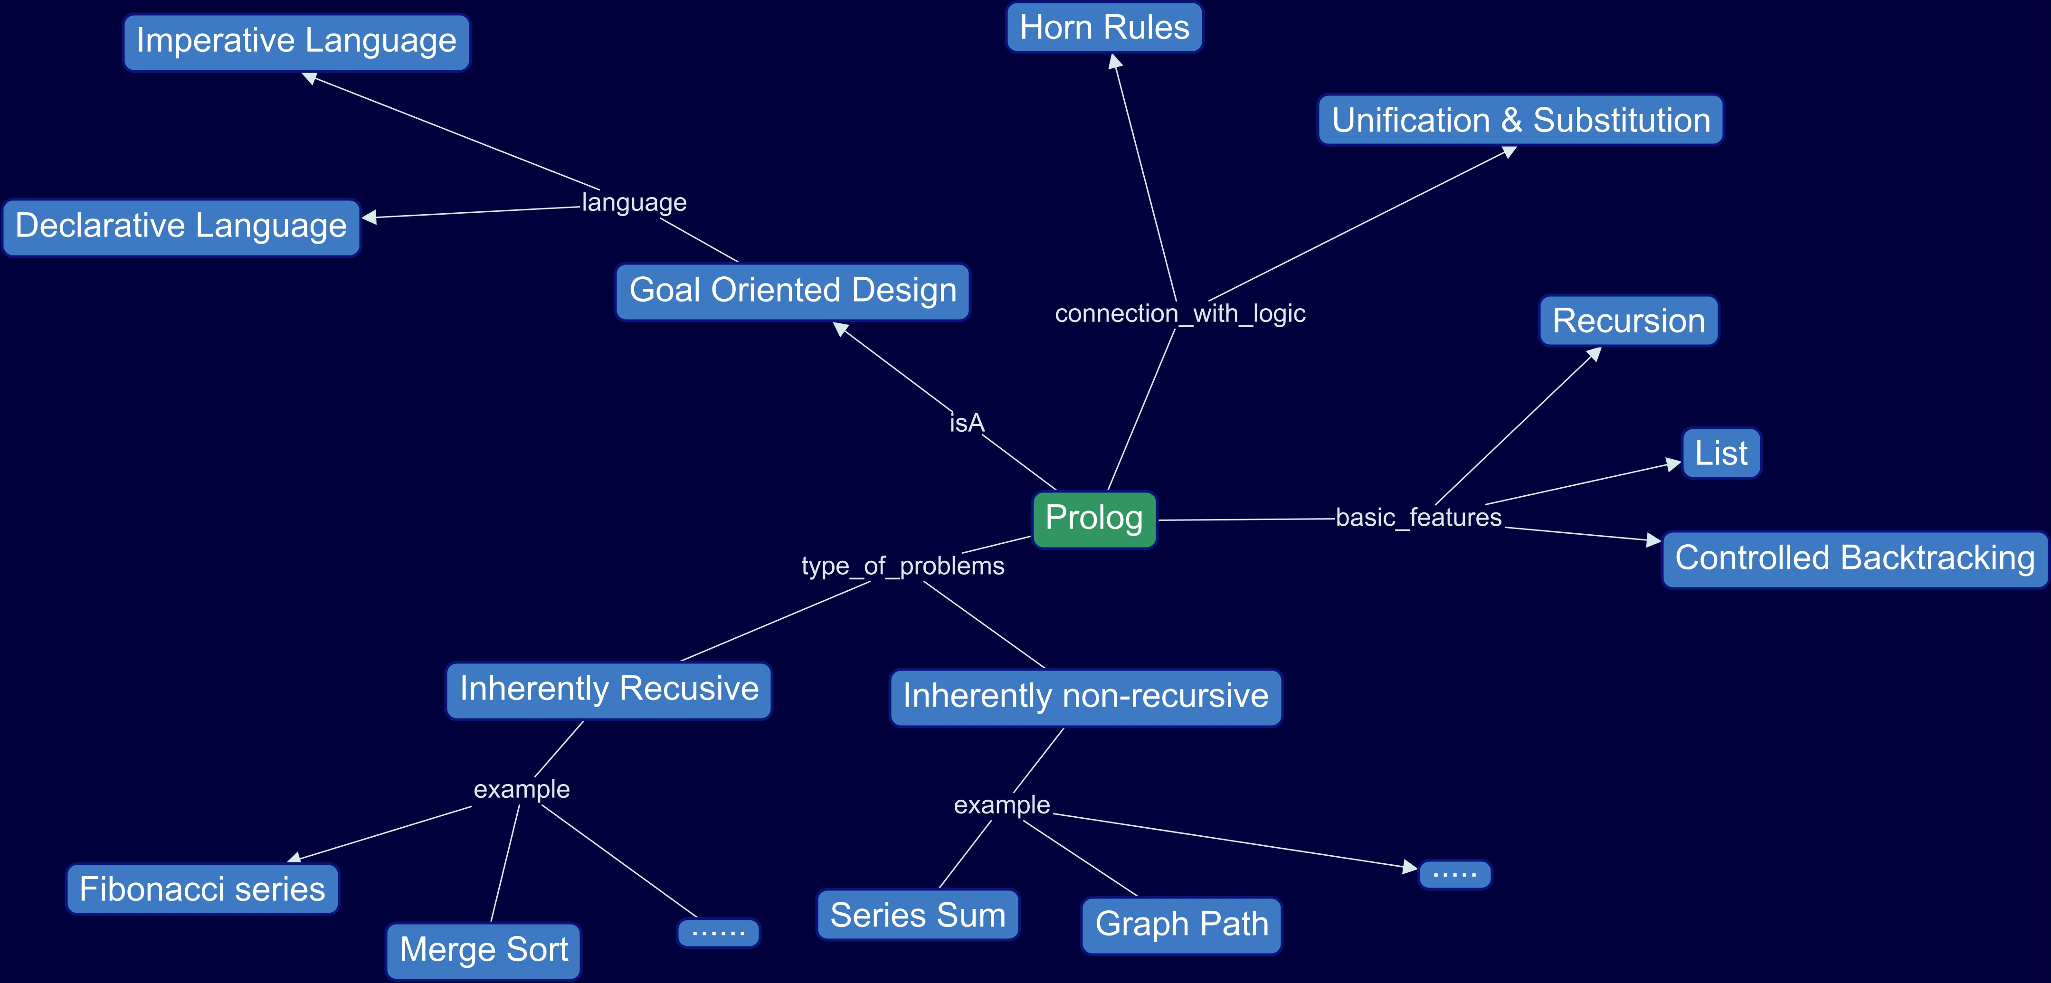


Slide 3





Goal Oriented Programming
Goal

Slide 4

Language Choice
“Known” languages like FORTRAN, C/C++, Java, python
Imperative: How-type language
Goal Oriented Languages (Declarative)
Declarative: What-type language
LISP
“Goal oriented programming is like reading Shakespeare in language other than English” – Patrick Winston
ProLog: Truly what-type language

Slide 5
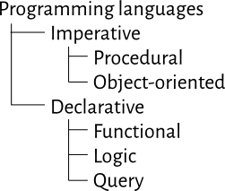

Imperative vs. Declarative
Imperative: Comprises a sequence of commands
Declarative: Declare what result we want and leave the language to come up with the procedure to produce them

Slide 6
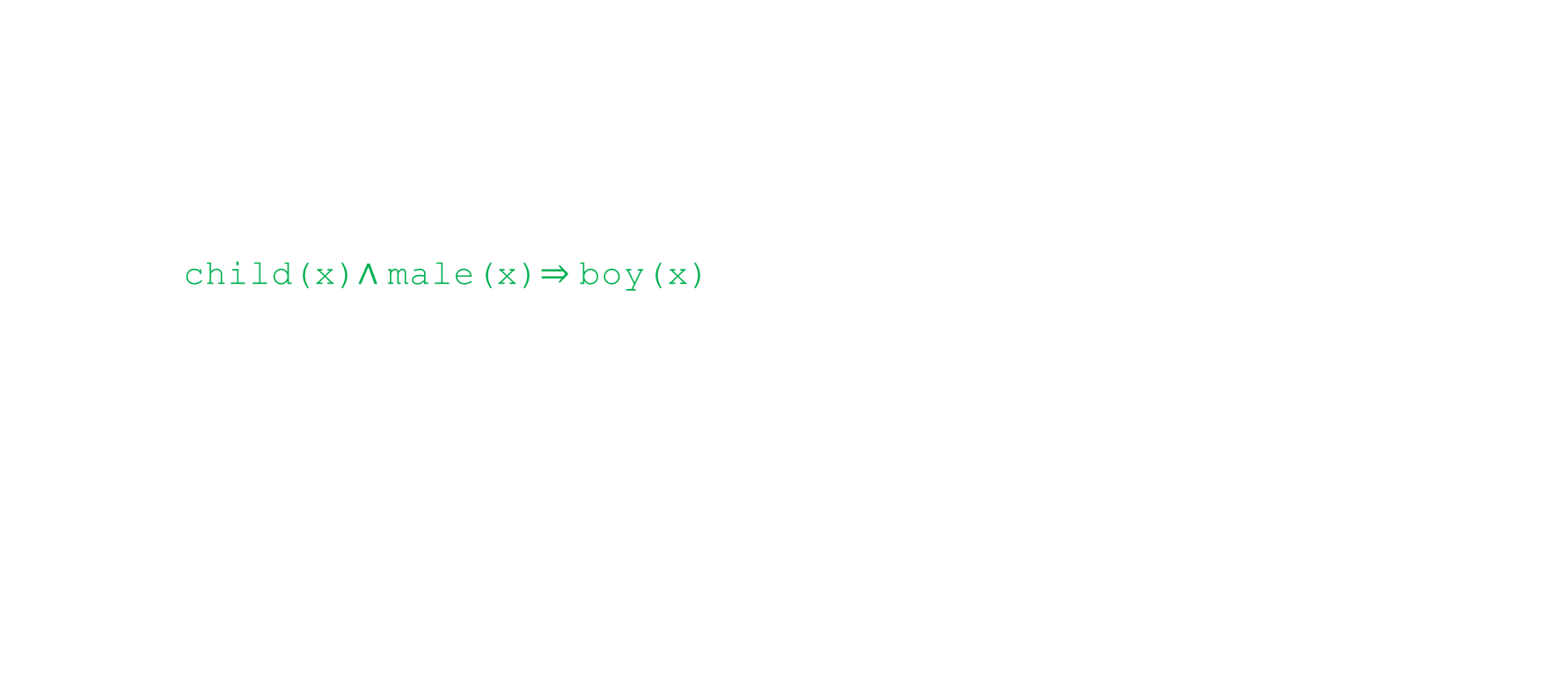

Prolog and First-Order Logic
Prolog language syntax
Horn Clause: CNF with implicit quantifiers and with at most one positive literal
child(x)$∧$male(x)$⇒$boy(x)
Prolog proof procedure
Resolution Principle
Prolog goal matching
Unification and substitution

Slide 7



A Confusion
child(x)$∧$male(x)$⇒$boy(x)
boy(x) :- child(x)$∧$male(x)

Slide 8

Prolog Computation Model
Program (Rules)
Facts (state)
Execute
Goal satisfied?
Goal (Query)
List of substitutions
(Answers)

Slide 9
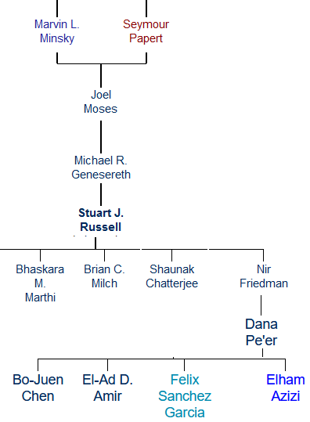

Prolog Facts
advisor(minsky, moses).
advisor(papert, moses).
advisor(moses, genesereth).
advisor(genesereth, russell).
advisor(russell, bhaskara).
advisor(russell, milch).
advisor(russell, shaunak).
advisor(russell, friedman).
advisor(friedman, dana).
advisor(dana, felix).
advisor(dana, chen).
advisor(dana, amir).
advisor(dana, azizi).
male(felix).
female(dana).

Slide 10

Prolog Rules
grand_advisor(X,Z) :- advisor(X,Y), advisor(Y,Z).
head (consequent)
body (antecedent )
$$∀_{X,Z}{ ∃}_{Y} advisor\left(X,Y\right)∧advisor(Y,Z) ⇒grand_advisor \left(X,Z\right)$$
IF there is a Y such that X is advisor of Y AND Y is advisor of Z
THEN X is a grand advisor of Z
Prolog rules are Horn Clauses:
$$(P_{11}⋁P_{12}⋁…P_{1m})∧…∧(P_{n1}⋁P_{n2}⋁…P_{nr})⇒Q$$
$$Q :− P_{11};P_{12};…;P_{1m} ,……,P_{n1};P_{n2};…{;P}_{nr}$$

Slide 11

Prolog Rules: Recursion
ancestor(X,Z) :-
advisor(X, Z).
ancestor(X,Z) :-
advisor(X, Y),
advisor(Y, Z).
ancestor(X,Z) :-
advisor(X, Y1),
advisor(Y1, Y2),
advisor(Y2, Z),

Slide 12
Prolog Rules: Recursion
ancestor(X,Z) :-
advisor(X, Z).
ancestor(X,Z) :-
advisor(X, Y),
ancestor(Y, Z).
X is an ancestor of Z if
X is an advisor of Y AND
Y is an ancestor of Z

Slide 13

How Prolog Answers?
ancestor(minsky, russell)
{X/minsky, Z/russell}
{X/minsky, Z/genesereth}
ancestor(X,Z) :-
advisor(X, Z).
ancestor(X,Z) :-
advisor(X, Y),
ancestor(Y, Z).
advisor(minsky, Y)
ancestor(Y, russell)
advisor(minsky, russell)
advisor(minsky, moses)
no
ancestor(moses, russell)
advisor(moses, genesereth)
?- ancestor(minsky, russell)
ancestor(genesereth, russell)
advisor(genesereth, russell)
yes

Slide 14
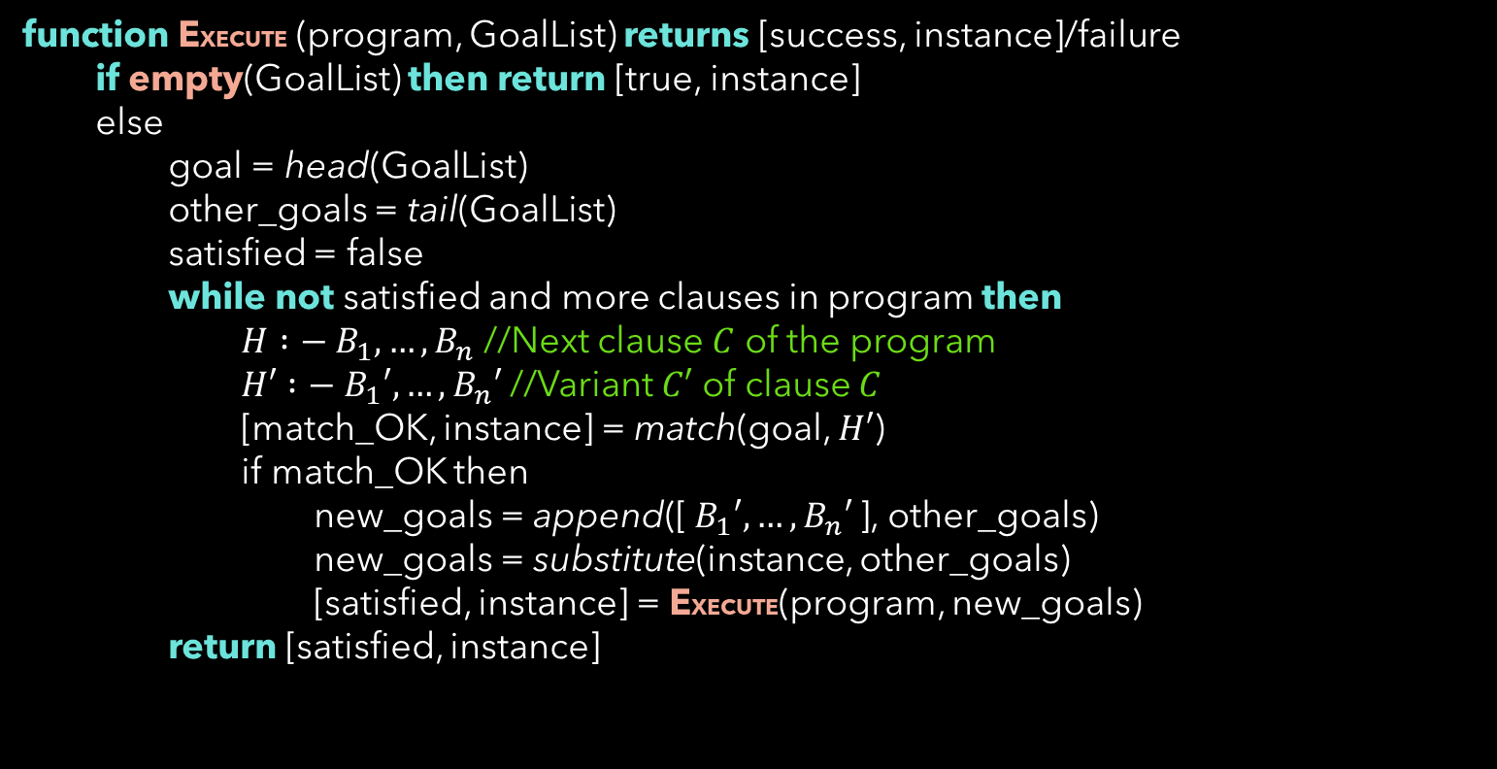

How Prolog Answers?
function EXECUTE (program, GoalList) returns [success, instance]/failure
if empty(GoalList) then return [true, instance]
else
goal = head(GoalList)
other_goals = tail(GoalList)
satisfied = false
while not satisfied and more clauses in program then
$H :−{ B}_{1},…, B_{n}$ //Next clause $C$ of the program
$H′ :−{ B}_{1}′,…, B_{n}′$ //Variant $C′$ of clause $C$
[match_OK, instance] = match(goal, $H′$)
if match_OK then
new_goals = append([${ B}_{1}′,…, B_{n}′$ ], other_goals)
new_goals = substitute(instance, other_goals)
[satisfied, instance] = EXECUTE(program, new_goals)
return [satisfied, instance]

Slide 15

Reordering of Clauses
ancestor1(X,Z) :-
advisor(X, Z).
ancestor1(X,Z) :-
advisor(X, Y),
ancestor1(Y, Z).
ancestor2(X,Z) :-
advisor(X, Y),
ancestor2(Y, Z).
ancestor2(X,Z) :-
advisor(X, Z).
Original
Clause swap
ancestor3(X,Z) :-
advisor(X, Z).
ancestor3(X,Z) :-
ancestor3(Y, Z),
advisor(X, Y).
ancestor4(X,Z) :-
ancestor4(Y, Z),
advisor(X, Y).
ancestor4(X,Z) :-
advisor(X, Z).
Goal swap
Clause & Goal swap

Slide 16
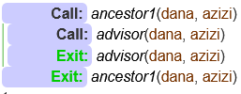

Reordering of Clauses
ancestor1(X,Z) :-
advisor(X, Z).
ancestor1(X,Z) :-
advisor(X, Y),
ancestor1(Y, Z).
Original

Slide 17
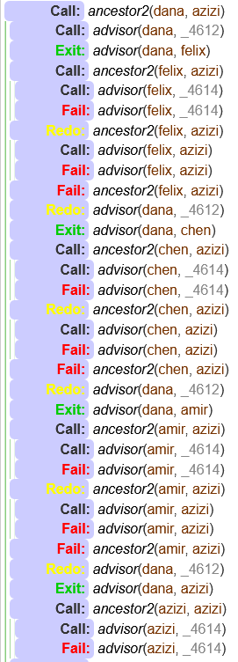

Reordering of Clauses
ancestor2(X,Z) :-
advisor(X, Y),
ancestor2(Y, Z).
ancestor2(X,Z) :-
advisor(X, Z).
Clause swap

Slide 18

Reordering of Clauses
ancestor3(X,Z) :-
advisor(X, Z).
ancestor3(X,Z) :-
ancestor3(Y, Z),
advisor(X, Y).
Quick Solution
Infinite Loop
Goal swap
?- ancestor3(bhaskara, felix)
ancestor4(X,Z) :-
ancestor4(Y, Z),
advisor(X, Y).
ancestor4(X,Z) :-
advisor(X, Z).
Infinite Loop
Clause & Goal swap

Slide 19

Takeaways from Ordering
Try simplest idea first (practical heuristics in problem solving)
ancestor1 being the simplest, ancestor4 being the most complex
Check your clause ordering to avoid infinite recursion
Procedural aspect is also important along with declarative

Slide 20

Some Example Programs
Numbers between two numbers:
between_number(N1,N2) :- N1<N2-1, N is N1+1, print(N),nl, NN1 is N1+1, between_number(NN1,N2).
Sum of the numbers in a range:
series_sum(N,N,N).
series_sum(N1, N2, Sum) :- N1<N2, N is N1+1,
series_sum(N,N2,SumInter),
Sum is SumInter + N1.

Slide 21

Prolog List Data Structure
List Data Structure:
[]
OR
[Head|Tail]
OR
[Item1, Item2,…|Others]
Examples:
Color1 = [maroon, green].
Color2 = [red, yellow].
Clubs = [mohanB, Color1, eastB, Color2].
L = [X1,X2|[X3,X4,X5]].

Slide 22

Prolog List Data Structure
Concatenation of two lists
Membership in list
Partition a list wrt a pivot

Slide 23

Prolog List Data Structure
Delete from list
A list is ordered or not
Max in a list

Slide 24

A Robot Playing with Blocks
- Robot sees from the top
- Robot can name the visible blocks and x-y coordinates.
a
see(a, 1, 5).
see(d, 4, 5).
see(e, 3, 1).
b
0 1 2 3 4 5 6 7 8 9 Y
c
d
- Positional relations
e
on(a, b).
on(b, c).
on(c, table).
on(d, table).
on(e, table).
0 1 2 3 4 5 6 X

Slide 25
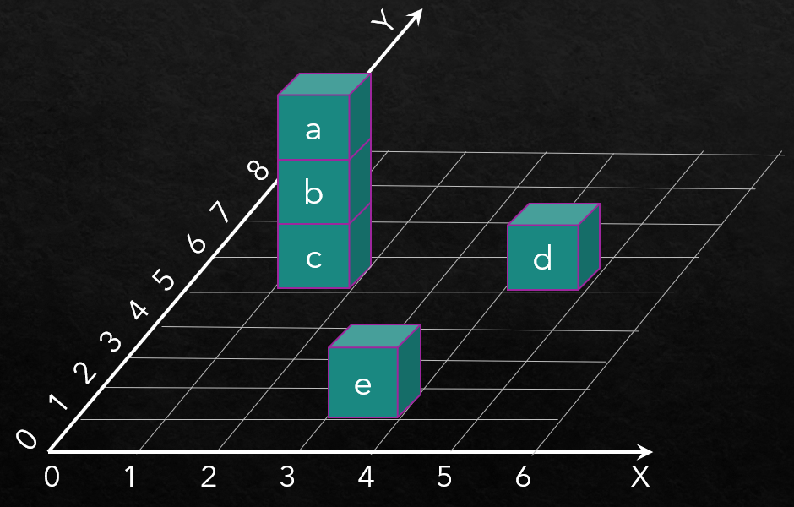

A Robot Playing with Blocks
- What are blocks in this world?
- Leftmost visible block
?- on(Block, _).
?- see(B,X,_),
\+ (see(B2,X2,_), (X2<X)).
- Pairs of blocks having the same y- coordinate
- Find the Z-coordinate of a block
z(B,0) :- on(B,table).
z(B,Z):- on(B,B0), z(B0,Z0), Z is Z0+1.
?- see(B1,_,Y),
see(B2,_,Y),
B1 \= B2.
- Find blocks b/w two blocks
- Boxes that are not visible
recursive_on(B1,B2) :- on(B1,B2).
recursive_on(B1,B2) :- on(B1,BX), print(BX), recursive_on(BX,B2).
?- on(B, _),
\+see(B, _, _).

Slide 26
Inherently Recursive Problems

Slide 27

Fibonacci Series
fib_seq(S, N) :-
N > 1,
fib_seq_(N, SR,1,[1,0]),
reverse(SR,S).
fib_seq_(N,Seq,N,Seq).
fib_seq_(N,Seq,N0,[B,A|Fs]) :-
N > N0,
N1 is N0+1,
C is A+B,
fib_seq_(N,Seq,N1,[C,B,A|Fs]).

Slide 28

Simple Sort
min(A, A, B) :- A =< B.
min(B, A, B) :- B =< A.
smallest(A, [A|[]]).
smallest(Min, [A|B]) :- smallest(SB, B),
min(Min, A, SB).
sorted([], []).
sorted([Min|RestSorted], List) :-
smallest(Min, List),
append(BeforeMin, [Min|AfterMin], List),
append(BeforeMin, AfterMin, RestUnsorted),
sorted(RestSorted, RestUnsorted).

Slide 29

Merge Sort

Slide 30
Inherently Iterative Problems

Slide 31

Path Finding in Graph
2
3
1
4
6
5

Slide 32

Knapsack Problem

Slide 33

N-Queens Problem

Slide 34
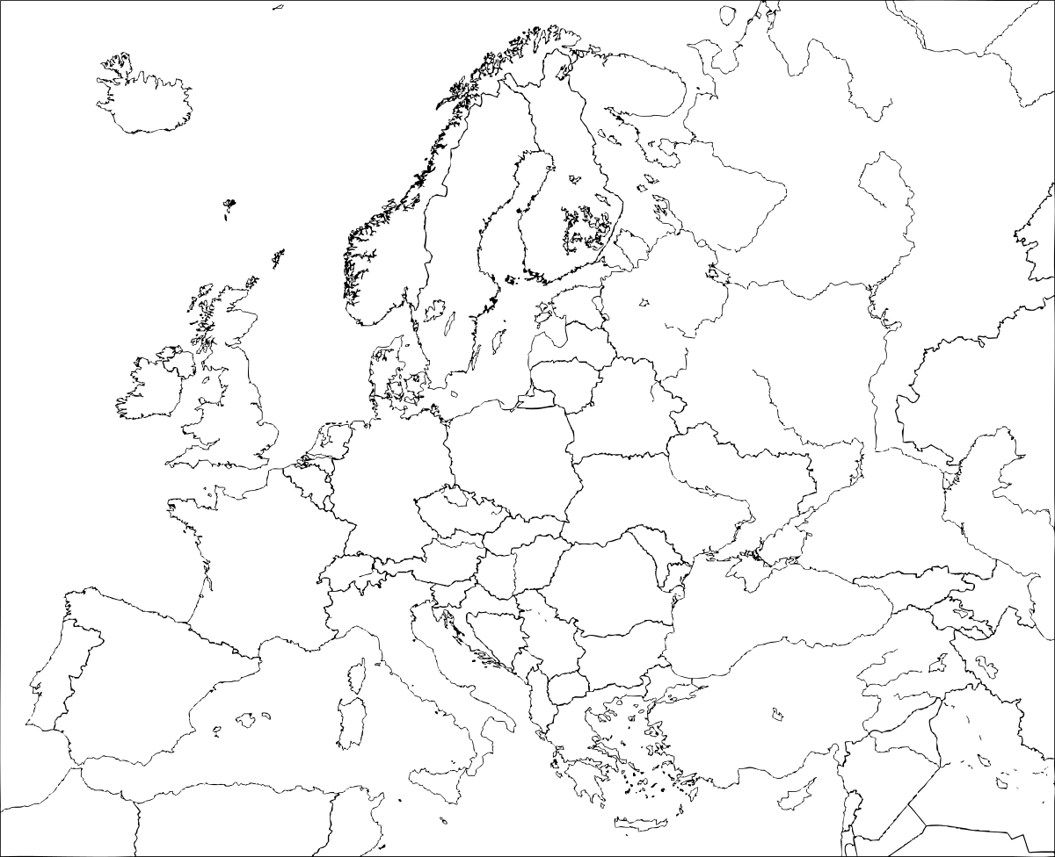
Map Coloring

